Slide 1


Prefer lowercase letters unless you need to emphasize things such as FEA, King Kong or H₂0
First AUTHOR, Second AUTOR, Third AUTHOR
Institution of the speaker(s). Underline the speaker above if he is not the first author.

Slide 2
Prefer lowercase letters unless you need to emphasize things such as FEA, King Kong or H₂0
your logo if you have some
Not necessary
title
authors
First AUTHOR, Second AUTOR, Third AUTHOR
Institution of the speaker(s). Underline the speaker above if he is not the first author.
affiliation

Slide 3
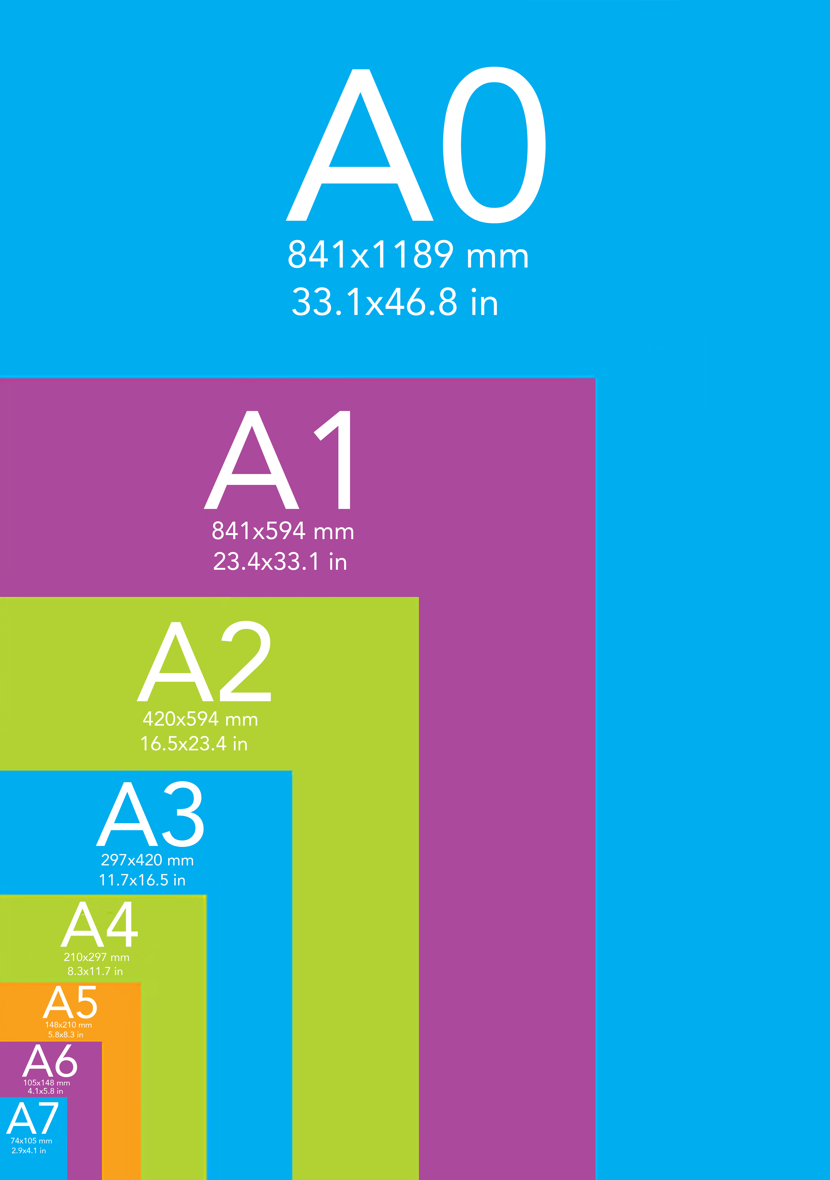
What you will show
A very short slide presentation (Powerpoint, PDF) according to the guidelines in this file.
A paper poster (ideally the A0 size).

Slide 4
Contents
Rather
Skip
This
Slide
Because
You
Only
Have
5 minutes...

Slide 5
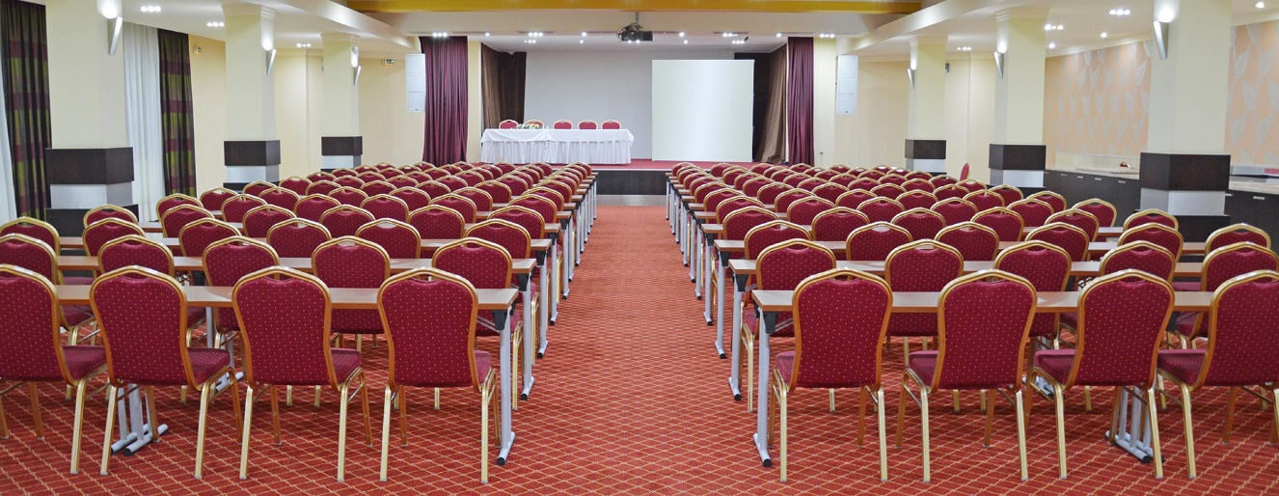


Fonts, colors and texts
Avoid using too many fonts, sizes, colors and weird contrasts.
Do not use too small or tiny fonts, because people far way will not be able to read it.
Avoid serif fonts, script fonts and Comics Sans.
Prefer short texts – avoid long sentences.
Also avoid too small spaces between text

Slide 6



Format
Use 16:9 format just like your monitor or TV screen
We will provide Full HD resolution projector (1920×1080 pixels)

Slide 7

Time
Send us your presentation before the conference or at least upload it before your session.
There are 5 minutes per poster presentation.
You will have additional at least 30 minutes for Q&A at your poster after the presentations.
Use your time to explain/compare what’s interesting on the slide and attract people to your poster.

Slide 8
That’s it
Thank you for making your presentation brief, comprehensible and interesting.

