Slide 1


Prefer lowercase letters unless you need to emphasize things such as FEA, King Kong or H₂0
First AUTHOR, Second AUTOR, Third AUTHOR
Institution of the speaker(s). Underline the speaker above if he is not the first author.

Slide 2
Prefer lowercase letters unless you need to emphasize things such as FEA, King Kong or H₂0
your logo if you have some
Not necessary
title
authors
First AUTHOR, Second AUTOR, Third AUTHOR
Institution of the speaker(s). Underline the speaker above if he is not the first author.
affiliation

Slide 3
Contents
Do not
Spend
Too much
Precious time
On this slide (this is not a book or a 3-hour lecture)
Rather use your speech and gestures to keep things understandable
At least do not read this all word by word...

Slide 4
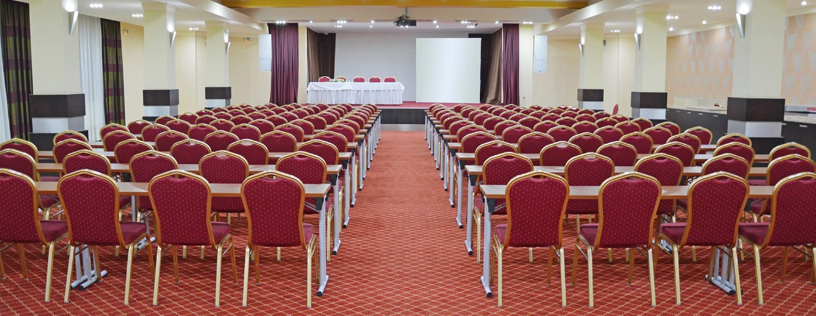


Fonts, colors and texts
Avoid using too many fonts, sizes, colors and weird contrasts.
Do not use too small or tiny fonts, because people far way will not be able to read it.
Avoid serif fonts, script fonts and Comics Sans.
Prefer short texts – avoid long sentences.
Also avoid too small spaces between text

Slide 5



Format
Use 16:9 format just like your monitor or TV screen
We will provide Full HD resolution projector (1920×1080 pixels)

Slide 6

Time
Send us your presentation before the conference or at least upload it before your session.
There are 20 minutes per presentation.
Try to stick with 15 minutes and allow 5 minutes for Q&A – you want feedback don’t you?
Do not try to read everything, the audience will always read it faster and could become bored.
Use your time to explain/compare what’s interesting on the slide.
You may totally skip “Contents” to save time.

Slide 7
That’s it
Thank you for making your presentation brief, comprehensible and interesting.

